Slide 1
Session 3: (Social and Emotional Interaction) Interaction Design Process & C o g n i t i v e P r i n c i p l e s i n I n t e r a c t i o n D e s i g n
by:
Ida Bagus Kerthyayana Manuaba
COMP6800001 - HCI

Slide 2

Review from Last Session:
What have we learned from Last week?

Slide 3

Session Learning Outcomes
Upon completion of this session, students are expected to be able to:
LO2: Analyze conceptual models for designers and users, knowledge of design and prototyping methods for user interfaces.
LO5: Implement a user interface that employs best practice principles

Slide 4

AGENDA
Interaction Design Process
What is interaction design process?
Interaction design process flow
Commonly used methods
User-Centered Design
Genius Design
Activity -Centered Design
Design Sprint
Issues that may appear
Cognitive Principles in Interaction Design
Getting to know human cognition Cognitively relevant theories Cognitive and interaction design User capabilities and limitations Cognitive application in interaction design Mental models in general

Slide 5

WHAT IS THE INTERACTION DESIGN PROCESS

Slide 6



WHAT IS THE INTERACTION DESIGN PROCESS?
a“ process...
Goal-Oriented problem-solving activities
Creative activity
Decision-making activities

Slide 7

WHAT IS THE INTERACTION DESIGN PROCESS?
MAIN PURPOSE :
Formulate interaction design
Determine the alternatives to use

Slide 8
INTERACTION DESIGN PROCESS FLOW

Slide 9


MAIN ACTIVITIES
1
2
3
4
DETERMINING NEEDS

Slide 10

MAIN ACTIVITIES
1
2
3
4
DETERMINING NEEDS
DESIGNING ALTERNATIVE DESIGNS

Slide 11

MAIN ACTIVITIES
1
2
3
4
DETERMINING NEEDS
DESIGNING ALTERNATIVE DESIGNS
PROTOTYPING

Slide 12

MAIN ACTIVITIES
1
2
3
4
DETERMINING NEEDS
DESIGNING ALTERNATIVE DESIGNS
PROTOTYPING
INTERACTION DESIGN EVALUATION

Slide 13
COMMONLY USED METHODS

Slide 14





COMMONLY USED METHODS
User Centered
Design
Genius Design
Activity Centered
Design
Design Sprint

Slide 15
USER CENTERED DESIGN
Abras, Maloney-Kr“ichmar, Preece (2004)
Focusing on design objectives to meet requirements and involving Users in Design Activities
Aim that the design product is made according to the needs and User expectations

Slide 16
1
UCD FLOW
START
Establishing
Requirements
₄ Evaluating
2
Designing
₃ Prototyping
Pree“ce (2015)
Final Product

Slide 17


FLOWS AND ACTIVITIES IN UCD
Abras, Maloney-Krichmar & Preece“(2004), Preece, Sharp & Rogers (2015)
1. (Establishing Requirements) Determining User Needs
Background interviews & Questionnaires Sequence of work interviews
On-site observations
Role-playing, walkthroughs & simulations

Slide 18

FLOWS AND ACTIVITIES IN UCD
Abras, Maloney-Krichmar & Preece“(2004), Preece, Sharp & Rogers (2015)
2. (Designing) Alternative Designs
Designing Information Architecture, Wireframing, the Interface

Slide 19

FLOWS AND ACTIVITIES IN UCD
Abras, Maloney-Krichmar & Preece“(2004), Preece, Sharp & Rogers (2015)
3. Make (Prototype)
Create a clickable mock-up Tools that can be used:
Figma | Invision App | Marvel App

Slide 20

FLOWS AND ACTIVITIES IN UCD
Abras, Maloney-Krichmar & Preece“(2004), Preece, Sharp & Rogers (2015)
4. Interaction Design (Evaluation)
Usability testing
Heuristic evaluation
Questionnaires

Slide 21


IN UCD, ENGAGING USERS IMPORTANT FOR…
Expectation Management
Ownership Aspect
To make sure user expectations is realistic
Users are Not surprised and Not disappointed with the design designed
Make a user become
active stakeholder
users will better understand the issues that arise
Decide product acceptance

Slide 22

USER ENGAGEMENT FORM
1
Users are included in the designer team
FULL TIME
User feedback is available at all times
Little user feedback, stressful
PART TIME
LONG TERM
Consistent
Inconsistency
SHORT TERM

Slide 23

USER ENGAGEMENT FORM
2
Through Newsletters / Social Media
Through various information dissemination media Can reach users from various backgrounds and groups at once There is a need to communicate two ways to submit feedback

Slide 24



GENIUS DESIGN
A method for designing an interaction design that relies on the expertise, experience, knowledge, and capabilities of visual design and user experience teams based on their assumptions and intuition.

Slide 25
GENIUS DESIGN
Broml“ey (2011)
Interaction design is created based on inspiration from designers / UX experts
Rely on visual design and UX teams to make decisions without significant external input
Relatively faster and less documentation

Slide 26
VS
Bromley (2011)
GENIUS DESIGN
Can be used when ...
USER-CENTERED DESIGN
Can be used when...
We want predictable and measurable results
User testing determines certainty in decision-making
The team wants to avoid risk (risk averse)
Sufficient funds and time
The team is experienced
There is a high trust in individual and team member’s intuition
already understand the user's purpose very well

Slide 27
ACTIVITY CENTERED DESIGN
Beaum“ont (2009)
https://medium.com/dermot-holmes/activity-centred-design-dd28ed1eec59
Focus on product stakeholder activities
Identify issues that arise from users

Slide 28
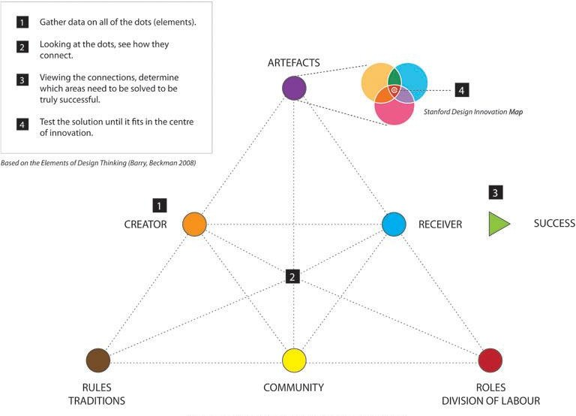
PROSES ACTIVITY CENTERED DESIGN
Beaumo“nt (2009)
https://medium.com/dermot-holmes/activity-centred-design-dd28ed1eec59

Slide 29
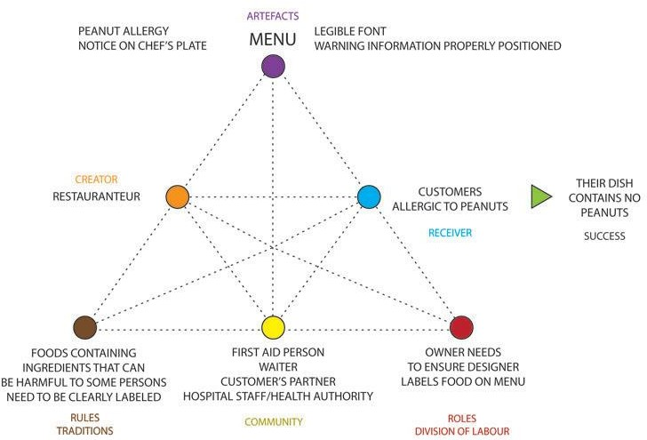
ACD CASE 1: RESTAURANTS AND ALLERGIES
Case 1 : A customer who has certain allergies orders a menu containing allergens in a restaurant
Beaumo“nt (2009)
https://medium.com/dermot-holmes/activity-centred-design-dd28ed1eec59

Slide 30
ACD CASE 1: RESTAURANTS AND ALLERGIES
Beaum“ont (2009)
https://medium.com/dermot-holmes/activity-centred-design-dd28ed1eec59
Some proposed solutions based on the ACD paradigm:
“The restaurant team discovers the rule and decides to look over the menu to ensure that any dish that might pose an allergy threat is identified.”
“The owner decides it is his/her role to communicate to the designer which dishes need warning labels and the owner will ensure that information is printed on the menu.”
“The designer, knowing the problem and working with the team, devises a system where customers know they need to inform the waiter of their allergy and their plate is specially marked in the kitchen to notify the staff of what food should not be on that plate.”

Slide 31
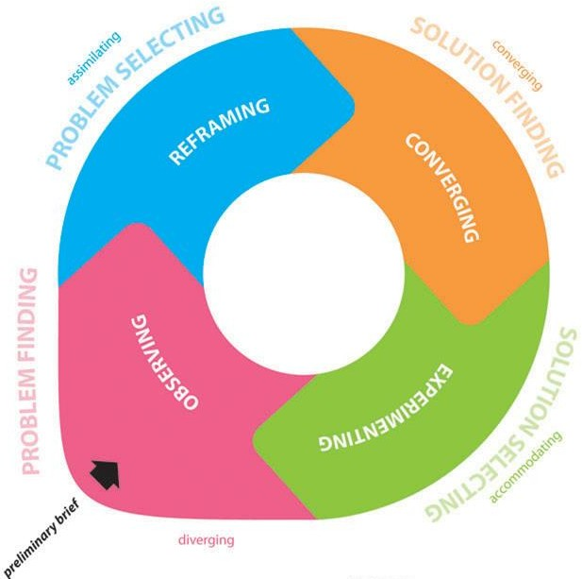
ITERATIVE DESIGN PROCESS IN ACD
Beaumo“nt (2009)
https://medium.com/dermot-holmes/activity-centred-design-dd28ed1eec59

Slide 32


DESIGN SPRINT
Direkova, Na“dya et al (2015)
https://www.hsredesign.org/wp-content/uploads/2019/02/Design-Sprint-Methods-002.pdf
Framework for designing and testing interaction designs in 5 days
Led by Sprint Master who is a UX Researcher and UX designer

Slide 33
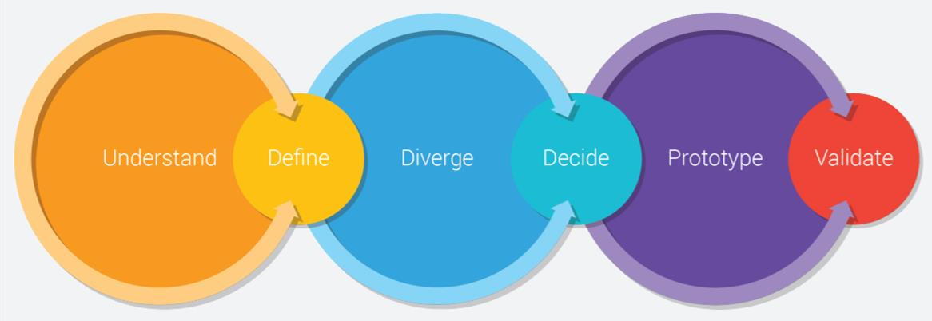
DESIGN SPRINT PROCESS FLOW
Direkova, Na“dya et al (2015)
https://www.hsredesign.org/wp-content/uploads/2019/02/Design-Sprint-Methods-002.pdf

Slide 34
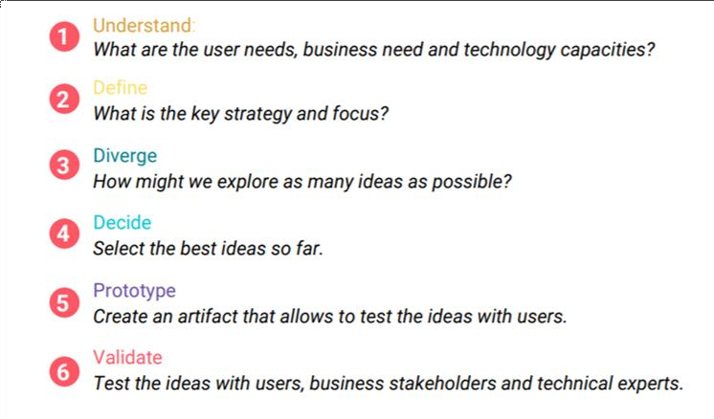
DESIGN SPRINT PROCESS FLOW
Direkova, Na“dya et al (2015)
https://www.hsredesign.org/wp-content/uploads/2019/02/Design-Sprint-Methods-002.pdf

Slide 35
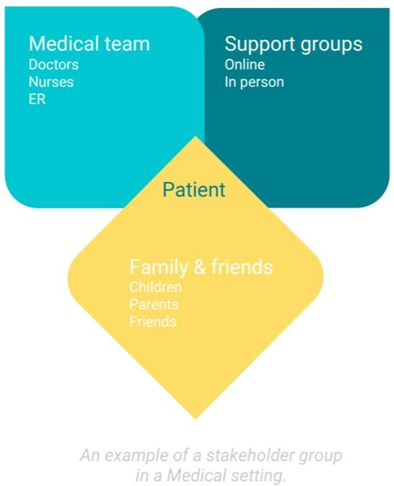
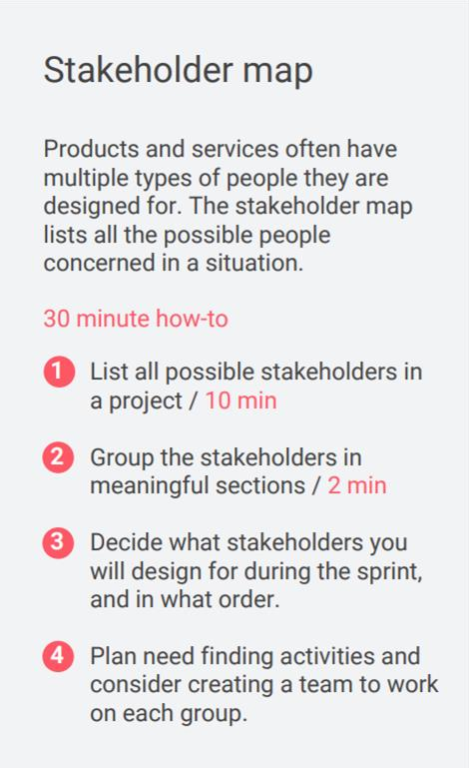
EXAMPLES OF ACTIVITIES IN DESIGN SPRINTS (1)
“ Direkova, Nadya et al (2015)

Slide 36
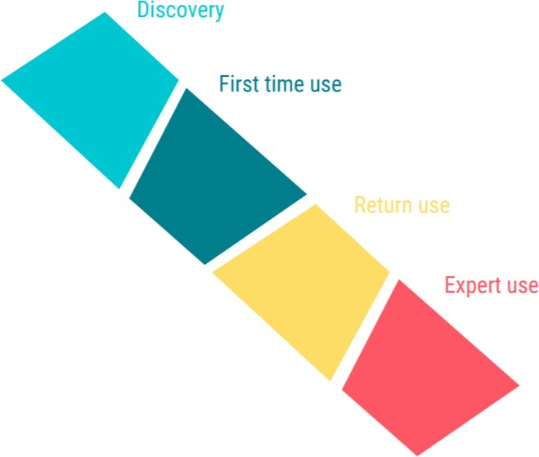
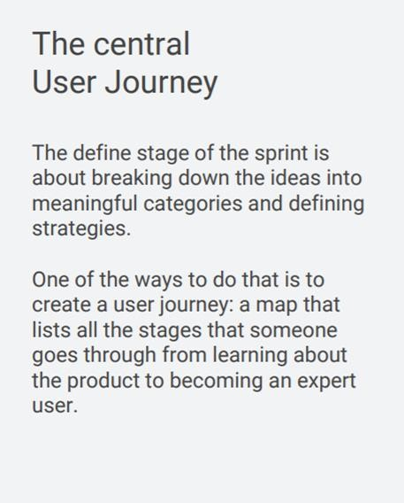
EXAMPLES OF ACTIVITIES IN DESIGN SPRINTS (2)
“ Direkova, Nadya et al (2015)

Slide 37
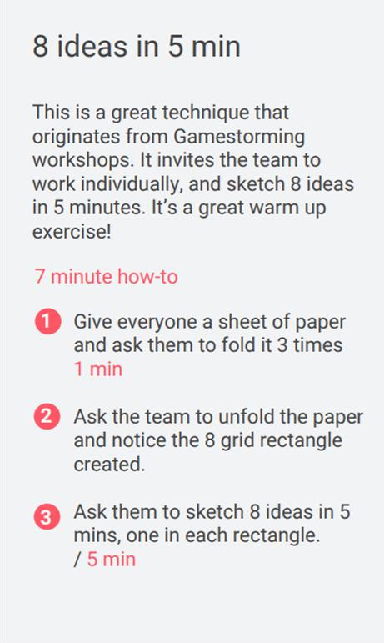
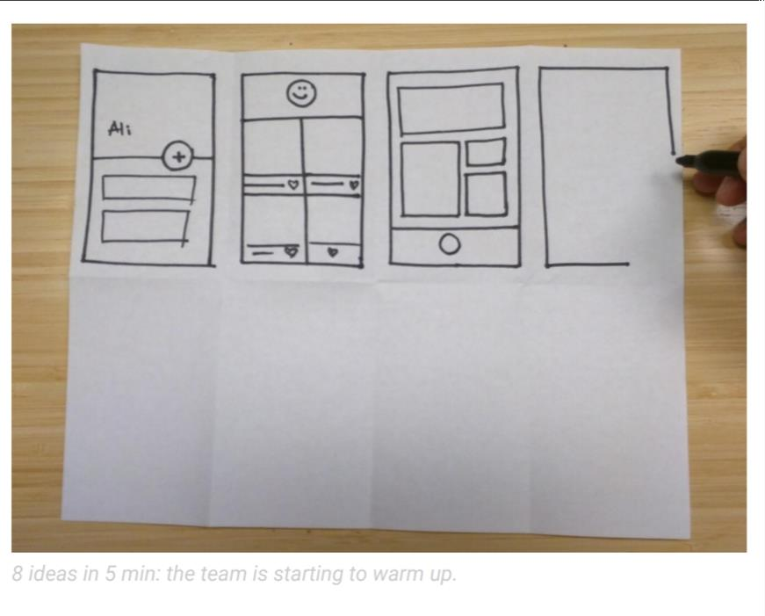
EXAMPLES OF ACTIVITIES IN DESIGN SPRINTS (3)
“ Direkova, Nadya et al (2015)

Slide 38
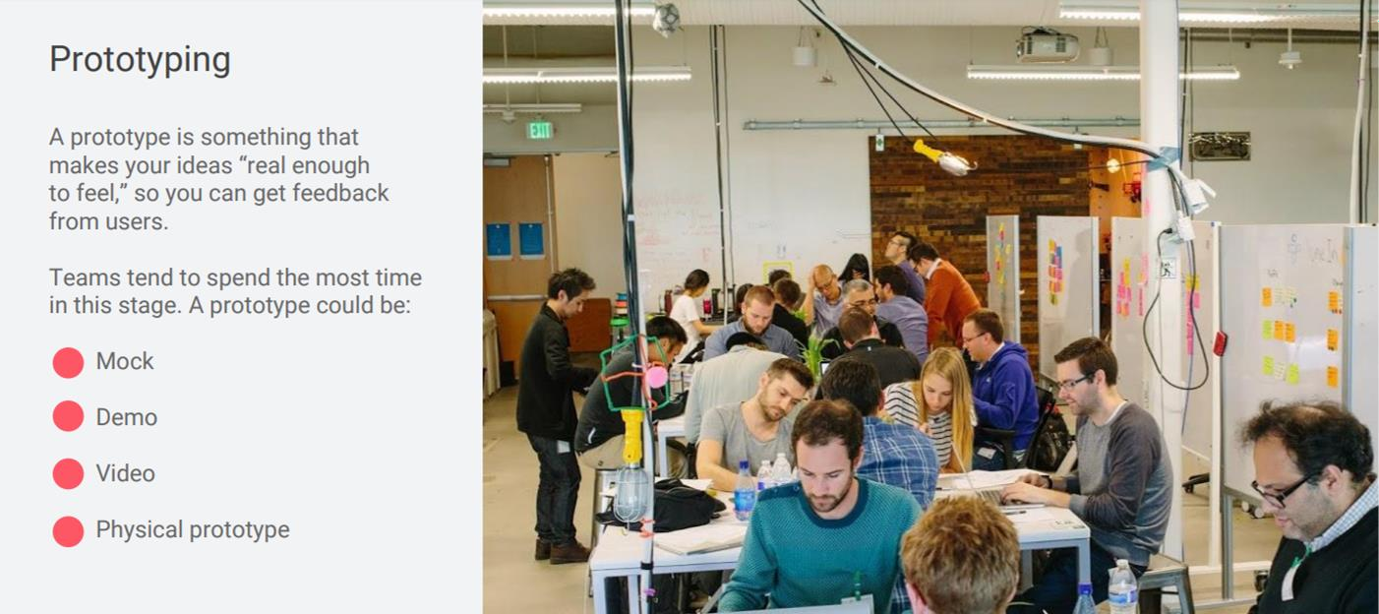
EXAMPLES OF ACTIVITIES IN DESIGN SPRINTS
“ Direkova, Nadya et al (2015)

Slide 39
ISSUES THAT MAY APPEAR

Slide 40

WHO ARE OUR APPLICATION USER? (1)
It's not as simple as we might think...
?
People who interact directly with their products
?
People who manage the user directly
People who obtain product output
People who determine the purchase decision
People who use competitors' products

Slide 41



WHO ARE OUR APPLICATION USER? (2)
Eason (1987) “formulate
Three Types of User Categories
Primary User
(frequent hands-on)
Secondary User
(occasional or through others)
Tertiary User
(Affected from the introduction or influencing the purchase of the product)

Slide 42
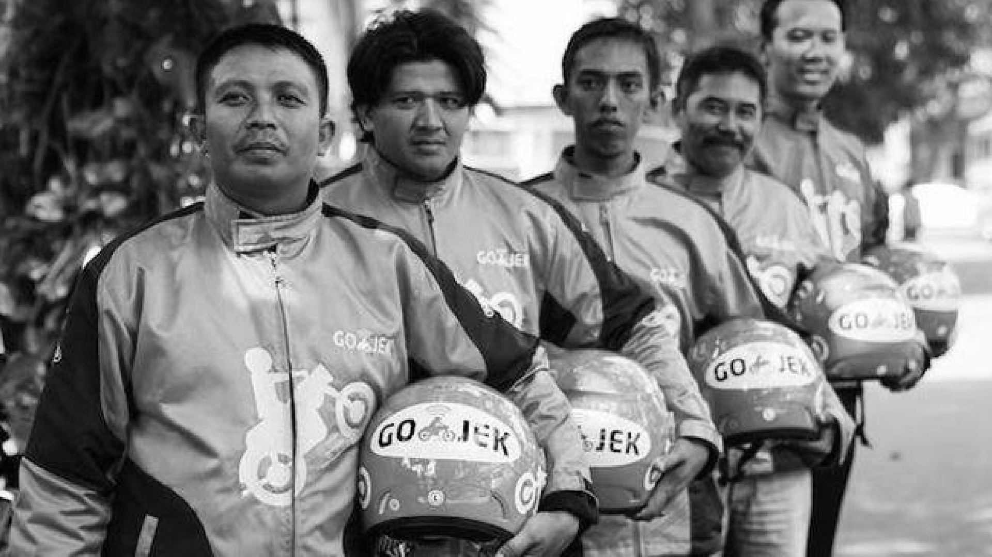
FOR EXAMPLE: GOJEK, WHO ARE THE STAKEHOLDERS?

Slide 43
Driver Ojek Online?
Passenger?
Business Partners?
Company Manager? App Developer ?

Slide 44


WHAT IS MEANT BY "NEED"? (1)
I want to be like this.
Users, when interviewed, are often...
User
I want to be that
Not knowing which ones are possible to make and which ones are not possible
Want this want that
So many...
It can be challenging to articulate the actual requirements that may assist them.
UX designer

Slide 45
WHAT IS MEANT BY "NEED"? (1)
Therefore, we need to observe the task
(usage activities) based on ....
What is the context?
What information is required?
Who collaborates to complete this task?
Why does the task completion have to be like this?

Slide 46

HOW TO PROPOSE AN ALTERNATIVE DESIGN?

Slide 47


Slide 48
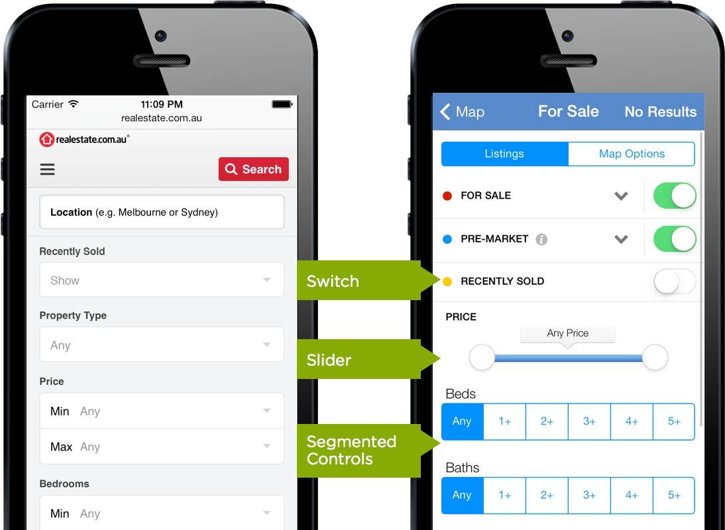
CHOOSING AVAILABLE ALTERNATIVES (1)
Credits :
Wroblewski, L (2015)
https://www.lukew.com/ff/entry.asp?1950

Slide 49
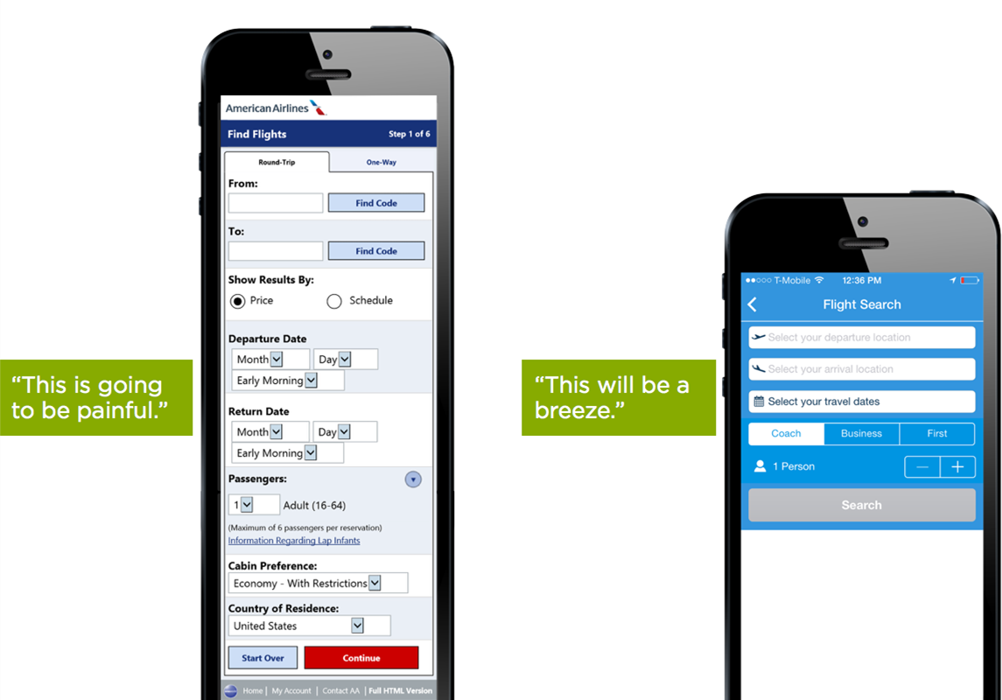
CHOOSING AVAILABLE ALTERNATIVES (2)
Credits :
Wroblewski, L (2015)
https://www.lukew.com/ff/entry.asp?1950

Slide 50

Cognitive Principles in Interactive Design

Slide 51

WHAT IS COGNITION?
https://blog.usertest.io/what-makes-a-good-ux-designer/

Slide 52

A mental or psychological process that occurs when a person understands or learns something
“
https://usabilitygeek.com/wp-content/uploa
ds/2017/09/ux-before-ui-main.jpg

Slide 53
PROCESSES INVOLVING COGNITION

Slide 54





PROCESSES INVOLVING COGNITION
ATTENTION
PERCEPTION
MEMORY
LANGUAGE
METACOGNITION

Slide 55

ATENTION
Selecting information as a centre of concentration

Slide 56


FACTORS AFFECTING ATTENTION
Goal:
Sort out which information is relevant which ones are not
Form of information:
Determine focus among relevant information

Slide 57
Heavy-level multitaskers are easily distracted and difficult to select information
“
Ophir et al (200)
https://usabilitygeek.com/wp-content/uploa
ds/2017/09/ux-before-ui-main.jpg

Slide 58
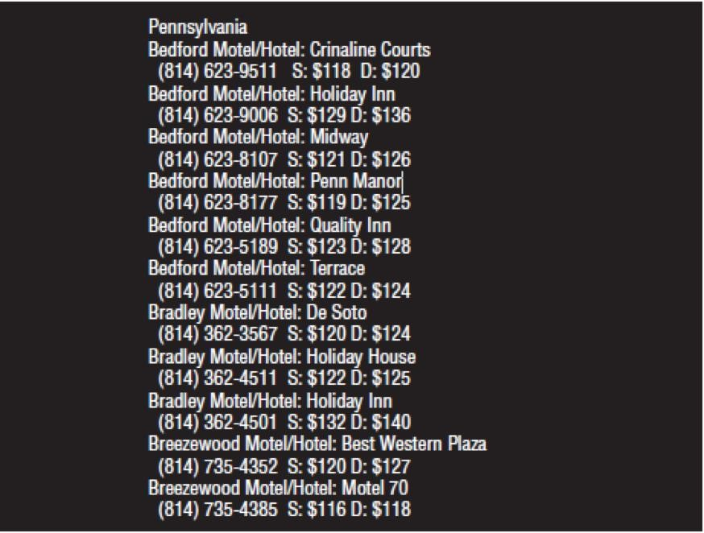
Find out double room prices in Quality Inn, Pennsylvania

Slide 59
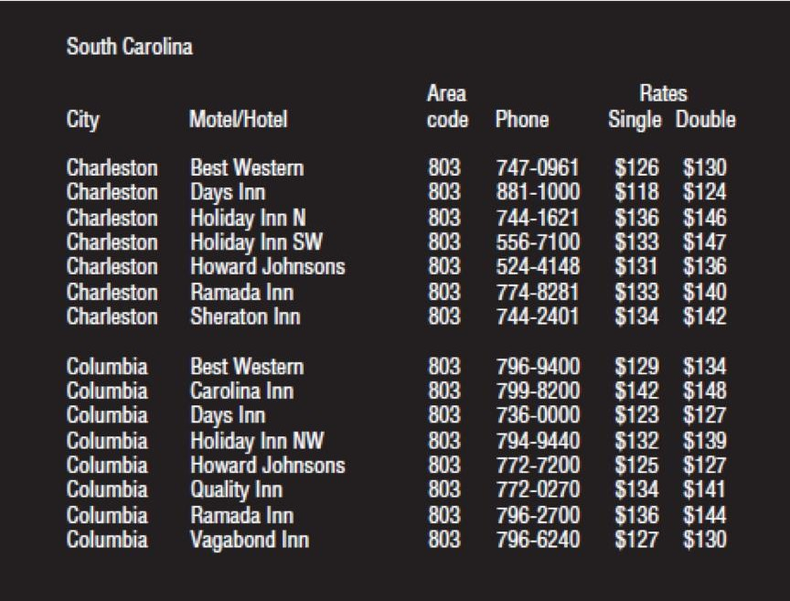
Is it easier than the previous one?
Find out double room prices in Holiday Inn, Columbia

Slide 60
“Grouping information according to relevance will speed up the user attention process

Slide 61
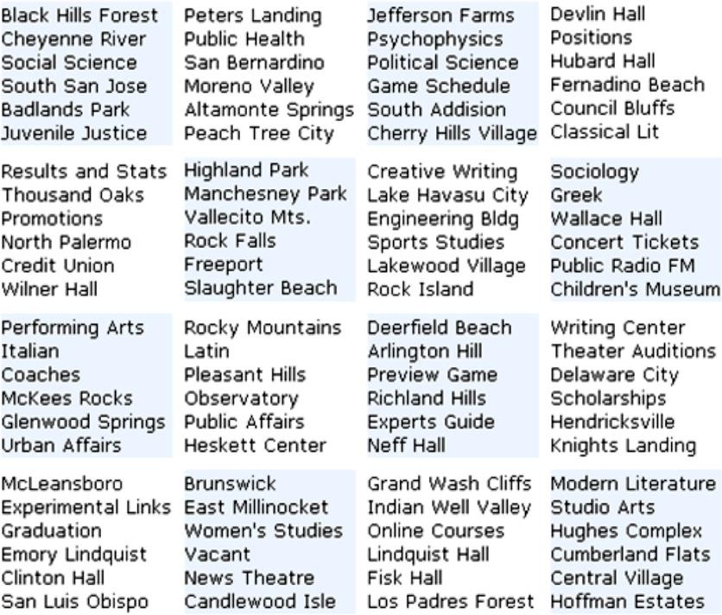
Try to find
‘Game Schedule’

Slide 62
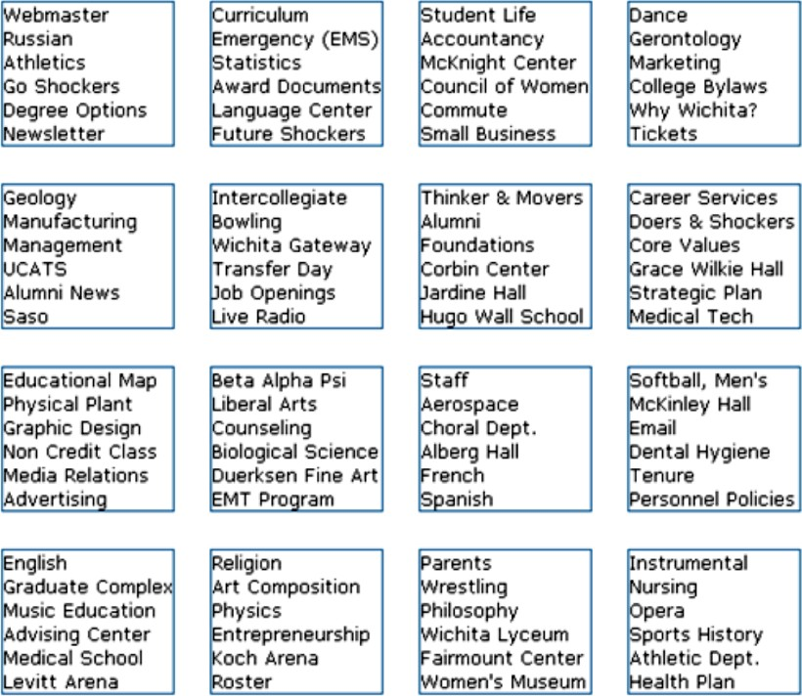
Is it easier than the previous one?
Now, try to find
‘Award Document’

Slide 63
“
The use of proper borders and spacing will give an effect 'grouping'

Slide 64
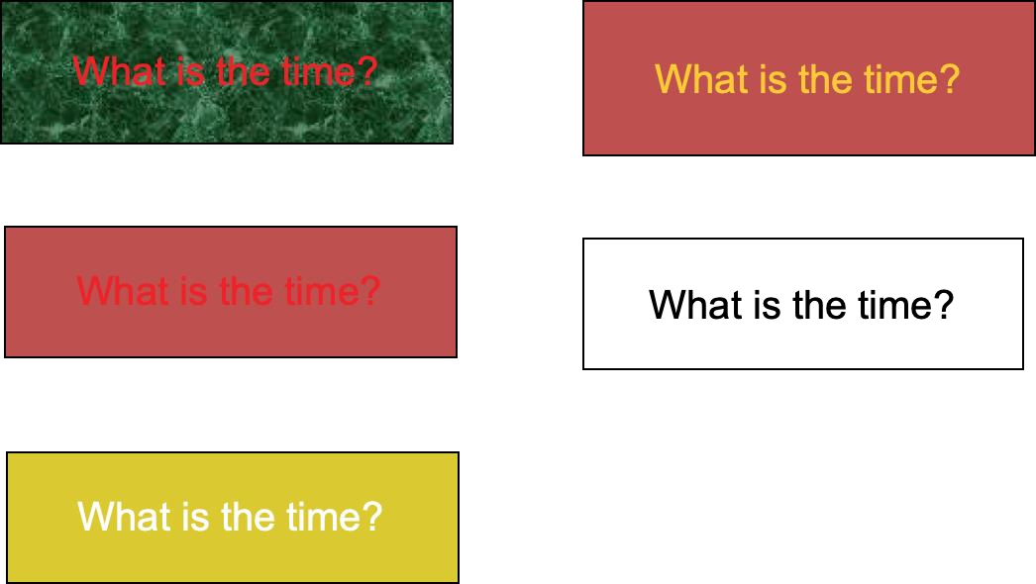
Which one is more convenient?

Slide 65

readability simplifies user understanding of intent and function
The faster the user selects information, the faster the user reaches his goal

Slide 66


ATTENTION AND THE 8 GOLDEN RULES
Permit easy reversal of actions
Support internal locus of control

Slide 67
PROCESSES INVOLVING COGNITION
ATTENTION
PERCEPTION
MEMORY
LANGUAGE
METACOGNITION

Slide 68
PERCEPTION
Provide meaning or understanding on an information

Slide 69


PERCEPTION IN INFORMATION
The user needs to understand the information received to decide whether the information is needed

Slide 70
“It is important to understand what the user understands and apply it to the design

Slide 71
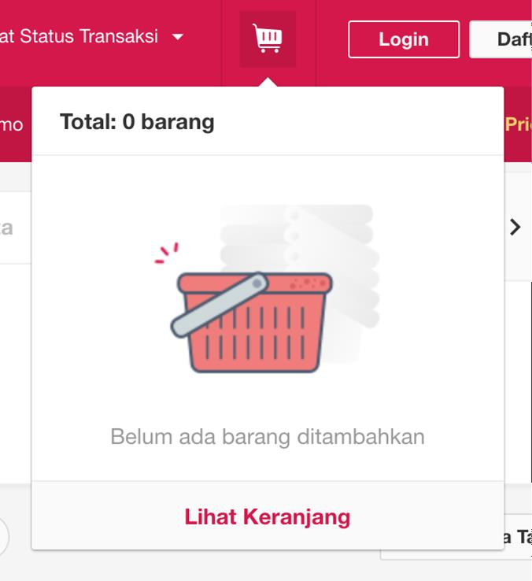
EXAMPLES OF THE APPLICATION OF PERCEPTION
Basket to describe the products to be purchased

Slide 72




PERCEPTION AND 8 GOLDEN RULES
Enable frequent users to use shortcut
Offer informative feedback
Design dialog to yield closure

Slide 73
PROCESSES INVOLVING COGNITION
ATTENTION
PERCEPTION
MEMORY
LANGUAGE
METACOGNITION

Slide 74
MEMORY
Internalization and externalization of information

Slide 75




MEMORY RELATED ISSUES
Can't remember all information
Requires context
It is easier to recognize than to recall

Slide 76
MEMORY RELATED ISSUES (1)
The stored information is selected and compared with previously possessed knowledge
Can't remember all information

Slide 77
MEMORY RELATED ISSUES (2)
Affects the extent to which stored information is recalled
Requires context

Slide 78
MEMORY RELATED ISSUES (3)
The brain must do depth processing for recall because it is in long-term storage
It is easier to recognize than to recall

Slide 79
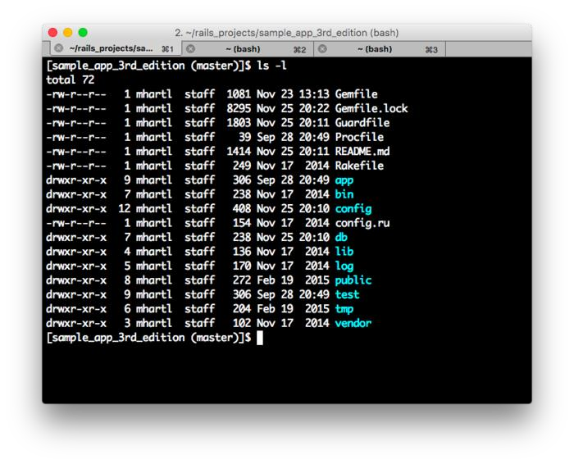
MEMORY IMPLEMENTATION EXAMPLES (1)
Command line interface for recall executed commands

Slide 80
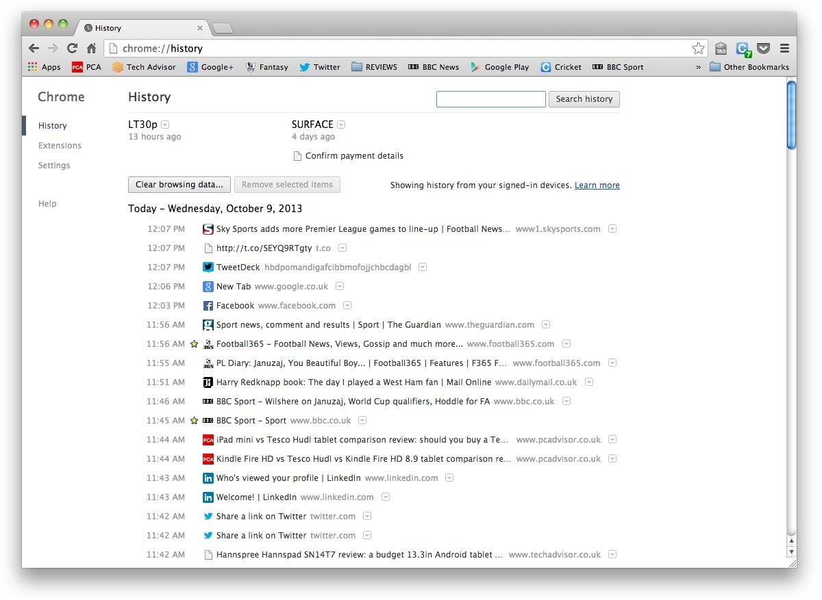
MEMORY IMPLEMENTATION EXAMPLES (2)
Searching history helps users to recognize

Slide 81
“Provide information or design as a user trigger to recognize

Slide 82


MEMORY AND 8 GOLDEN RULES
Strive for consistency
Reduce short-term memory load

Slide 83
PROCESSES INVOLVING COGNITION
ATTENTION
PERCEPTION
MEMORY
LANGUAGE
METACOGNITION

Slide 84

LANGUAGE
Speaking, listening, reading

Slide 85
PROCESSES INVOLVING COGNITION
ATTENTION
PERCEPTION
MEMORY
LANGUAGE
METACOGNITION

Slide 86
METACOGNITION
Planning, Decision making, Troubleshooting

Slide 87

MENTAL MODEL
Mental models are people's internal representations of external systems. (Craik, 1943)
How we think how things work…
One phenomenon can be represented by several mental models
One mental model can be used to represent several phenomena

Slide 88
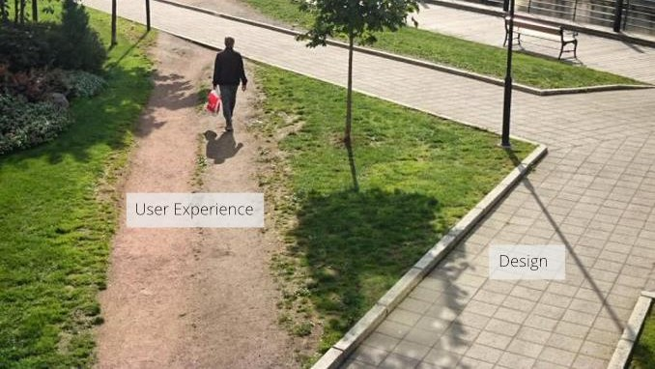
Image and Analogy

Slide 89
“Supply and demand is a mental model that represents how the economy works

Slide 90
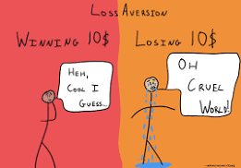
“
In psychology, loss aversion is used to represent the human tendency to avoid loss

Slide 91
SHALLOW
DEEP
Supply and demand is a concept that encompasses the end-to-end process and is used in all kinds of businesses
The path describes the user experience but does not describe how the user experience works
(one example of poor UX)
VS

Slide 92



MENTAL MODEL ISSUES
ACCURACY
Generalization of many phenomena with only a mental model
RESEMBLANCE
Limited to the perception and knowledge of the mental maker of the model
DEPTH
Cannot represent in detail according to the original phenomenon occurs if the phenomenon is too specific

Slide 93
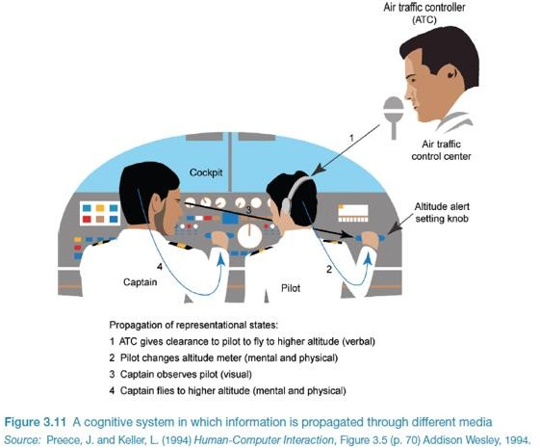
DISTRIBUTED COGNITION
Knowledge and cognitive processes do not happen solely inside the head, but are the result of various objects, humans, artifacts, or tools around

Slide 94
“
The more often interactions occur with the environment, the deeper the understanding or knowledge possessed

Slide 95



EXTERNAL COGNITIVE
How humans interact with external representations (maps, diagrams) and Serves to reduce memory load (shopping notes, deadline reminders)

Slide 96





COMPUTATIONAL OFFLOADING
The need for aids to externalize cognition.
Example is a pen and paper for making shopping notes

Slide 97


ANNOTATIONS AND COGNITIVE TRACING
ANNOTATIONS
Involves changing existing representations by providing signs,
e.g., checklists and underscores
COGNITIVE TRACING
Involves manipulating representation components into a new order, suppose completed work is moved to a lower order in the application

Slide 98
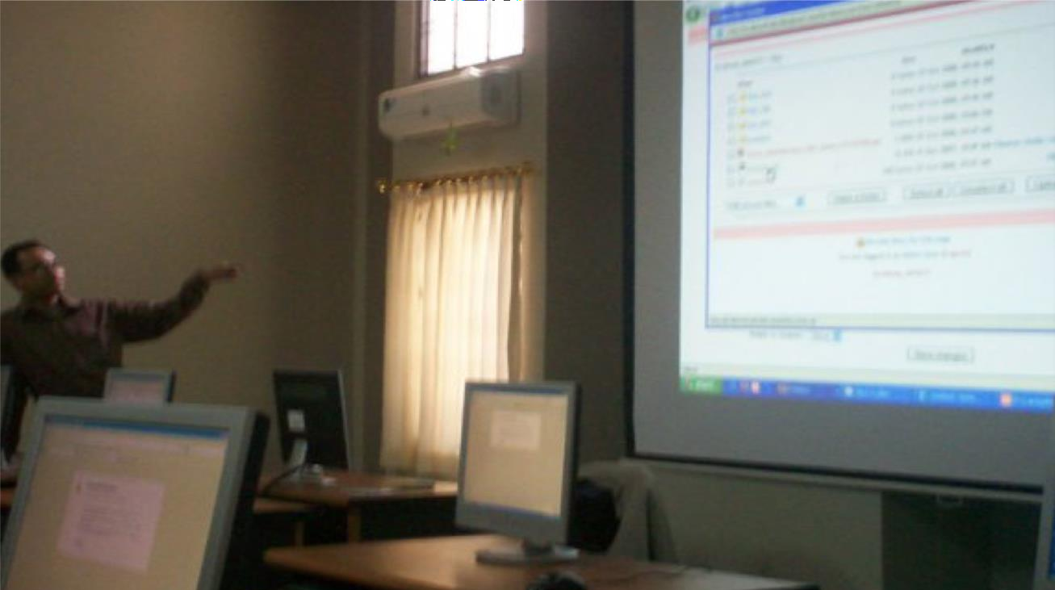
Thank You,
Questions?

Slide 99

Lab Session
Form and Table in HTML

Slide 100

Assignment 2: Requirements
﻿﻿Create index.html file.
﻿﻿Write all HTML code in html file and save it into your NEW repository
﻿﻿In html file create a form and under the form, you need to create a table with fieldset, colspan and rowspan options.
﻿﻿Set the title of the webpage ”HCI ASSIGNMENT-02".
﻿﻿Set the background image of the web page (select any nice background image).
﻿﻿Set the top heading for the title and put it on the centre.
Be creative and add any necessary information required for your form
﻿﻿Re-arrange the form page according to the table .
﻿﻿The page must contain a radio button, checkboxes, and a date with a calendar option.

Slide 101
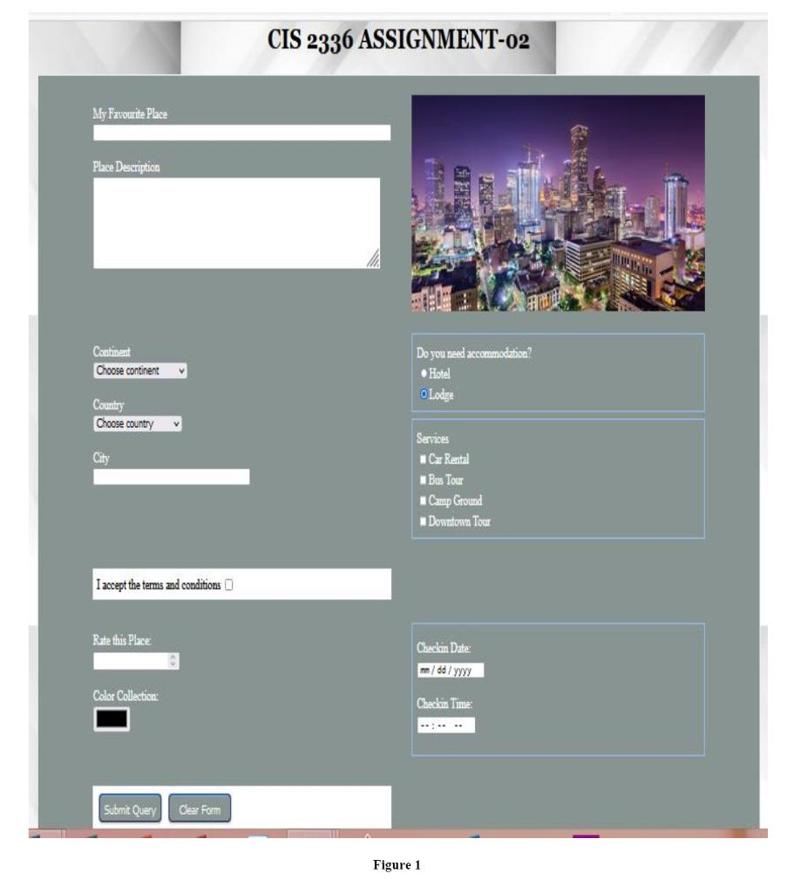
Assignment 2: Sample Solution:

Slide 102
Assignment 2: Submit Instruction
Please save your work to your GitHub repository, create a live link, and make sure it can be accessed anywhere, then submit the links (both repo and live links) through this form: https://forms.office.com/r/NVMv3ULv6u
Due Date: Tomorrow, before 9 PM

Slide 103
References
https://medium.com/dermot-holmes/activity-centred-design-dd28ed1eec59
https://www.hsredesign.org/wp-content/uploads/2019/02/Design-Sprint-Methods-002.pdf
https://www.programiz.com/html/form
https://www.programiz.com/html/table
https://www.chegg.com/homework-help/questions-and-answers/assignment-2-html-form-table-individual-assignment-purpose-assignment-focus-creating-diffe-q109317880

